Slide 1
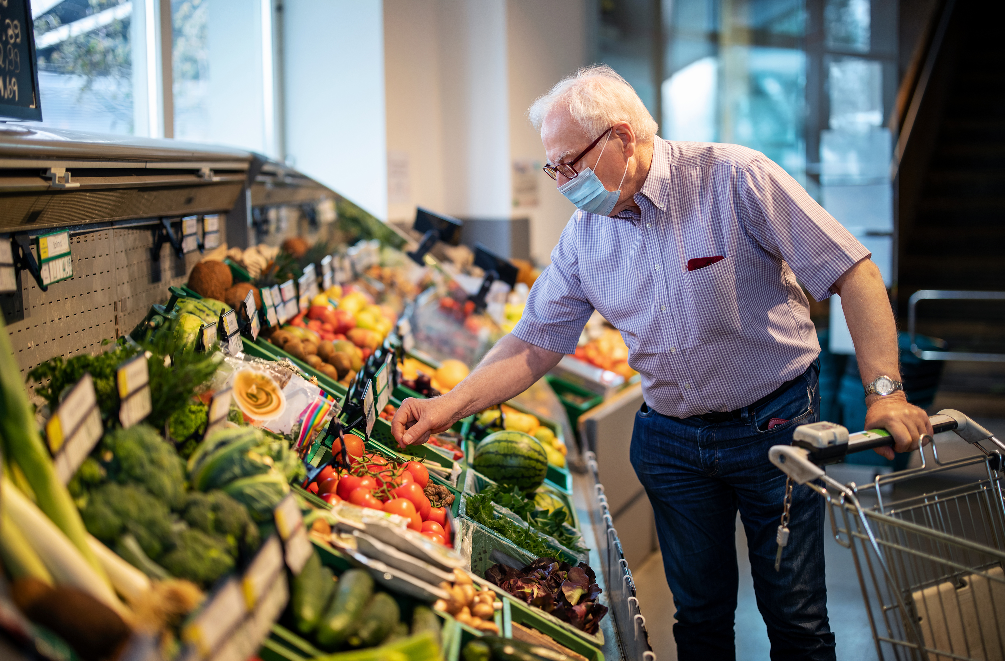

Innovating. Shopping. Experience.
Green Team: Edita, Femke, Jop & Luke

Slide 2

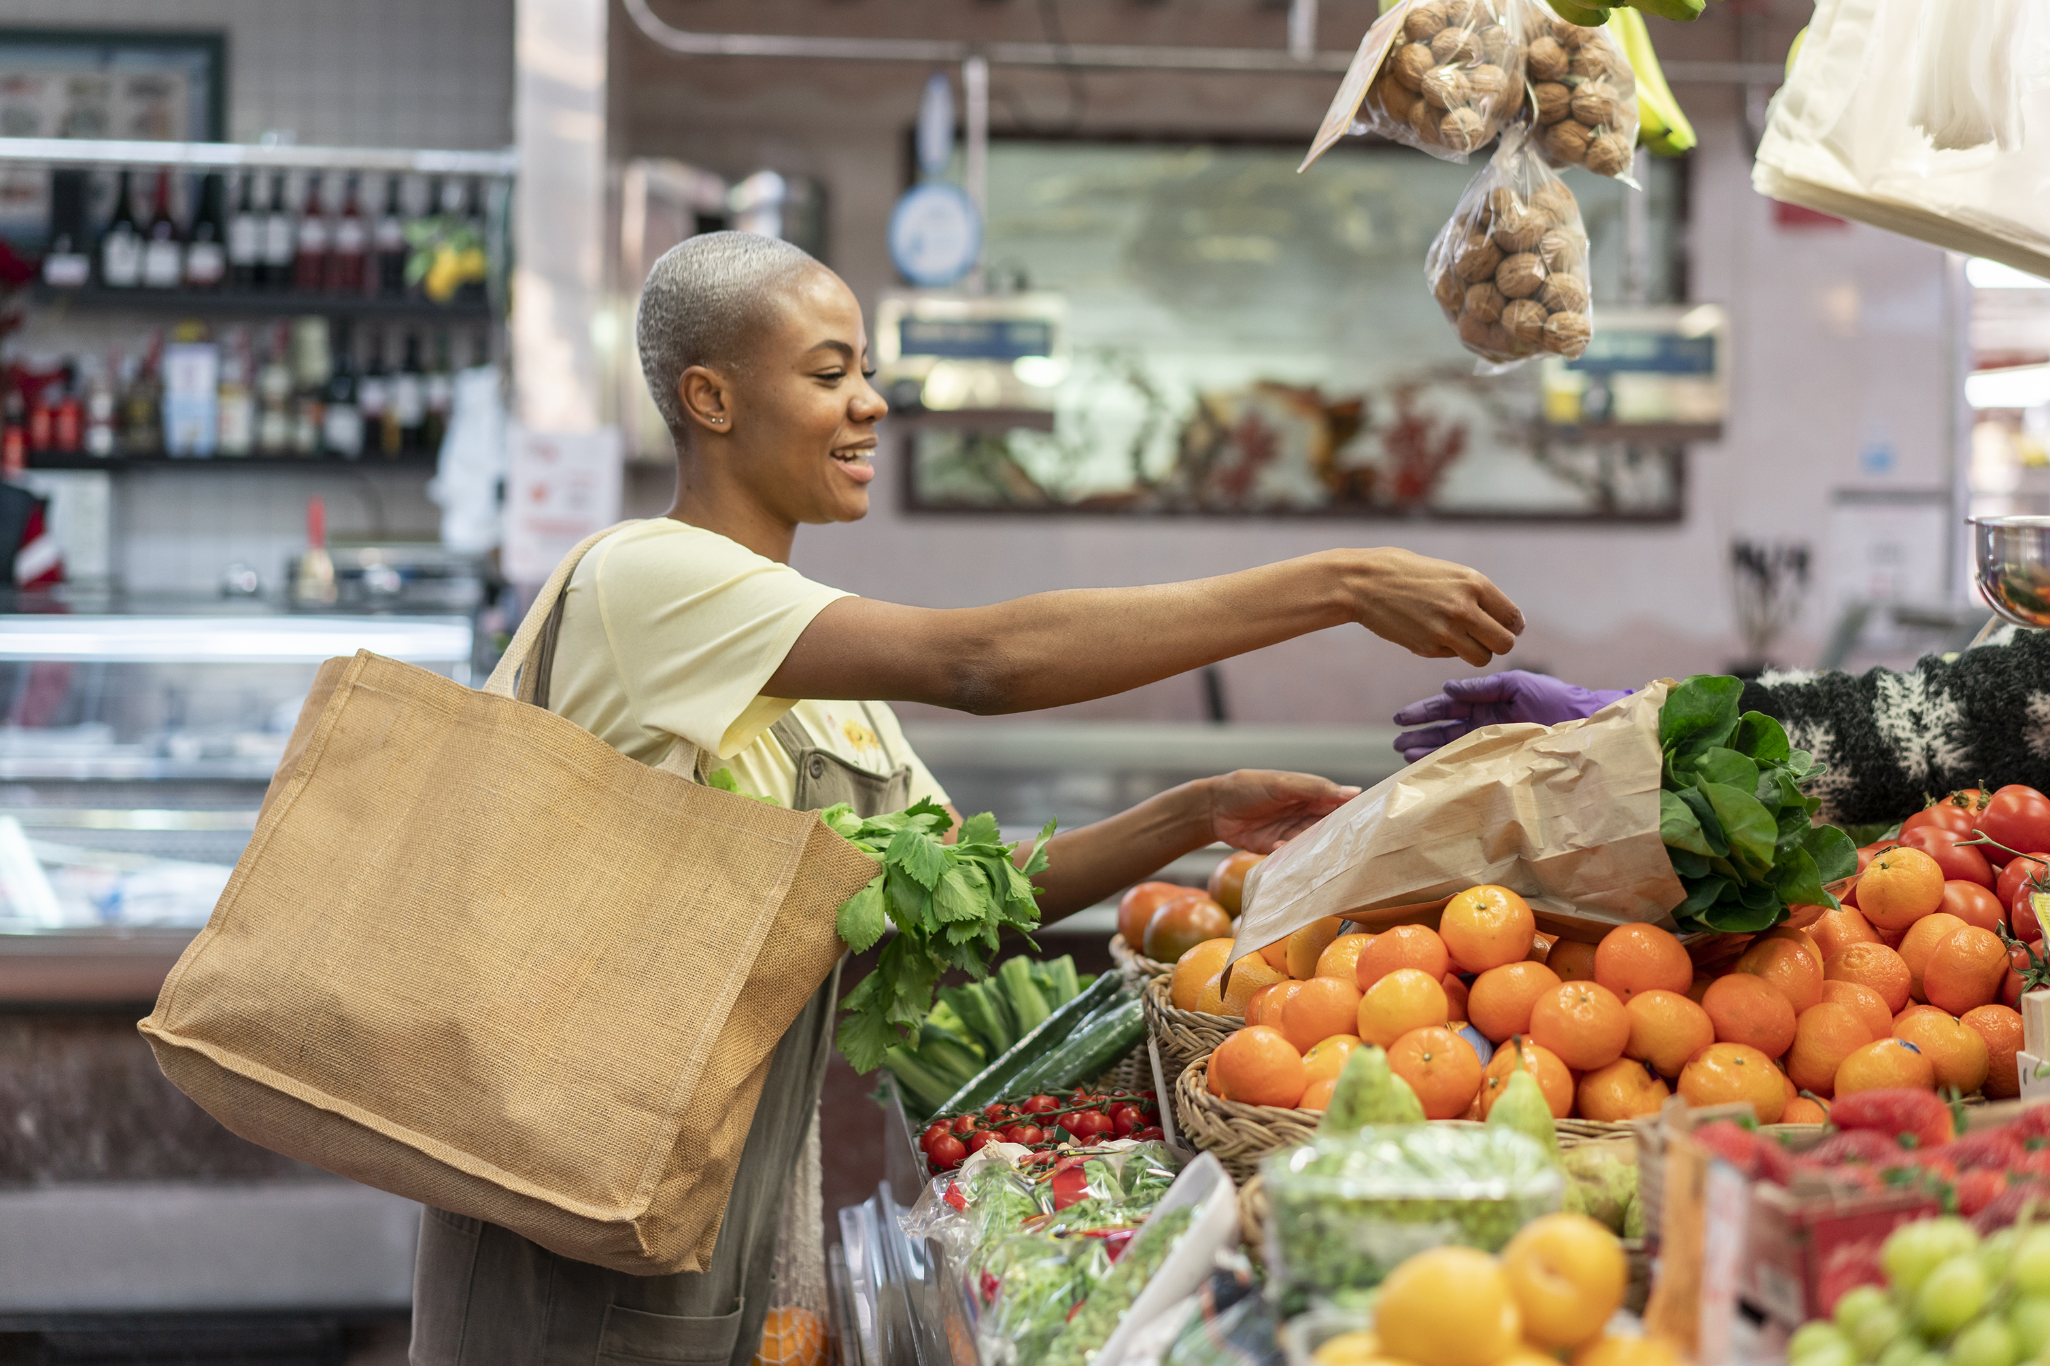
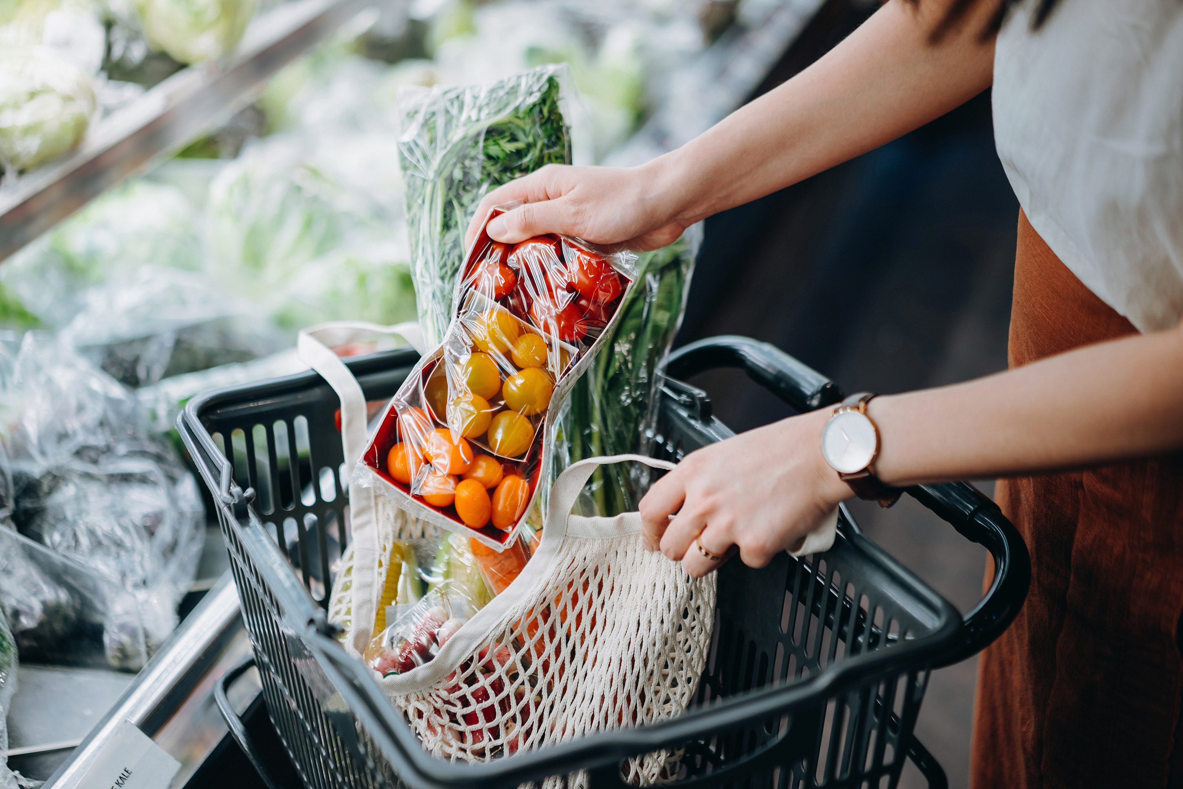
Contents
PC ideas
Challenges
Jumbo Riddles
Jumbo Live Speurtocht
Store Navigation
Karel the Cart
Idea
Features
Notes:
Inspiration from Jumbo philosophy as well as competitor analysis

Slide 3
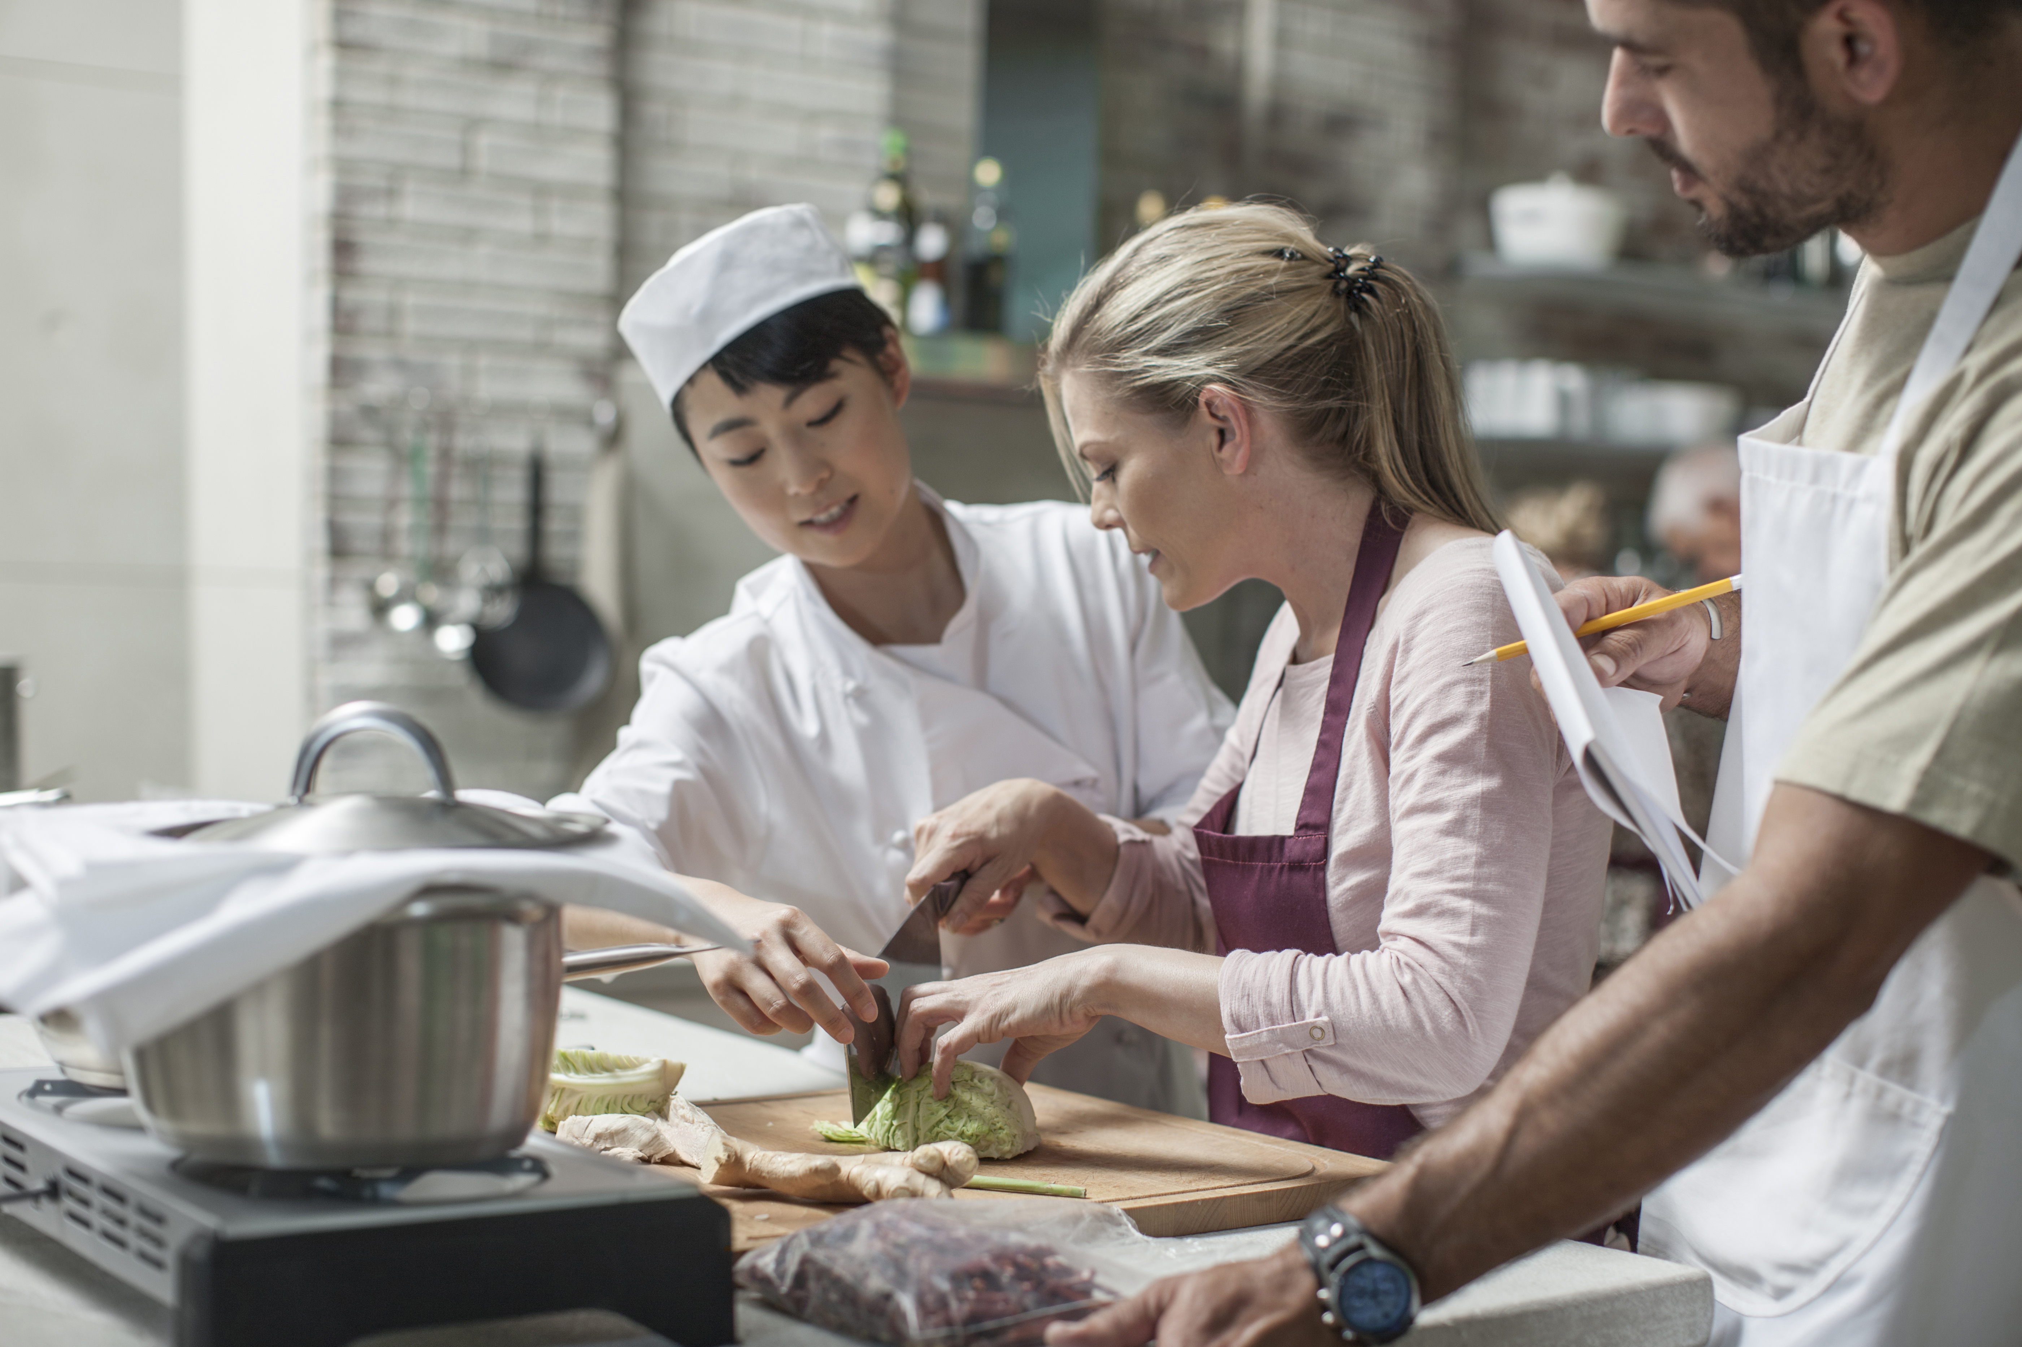
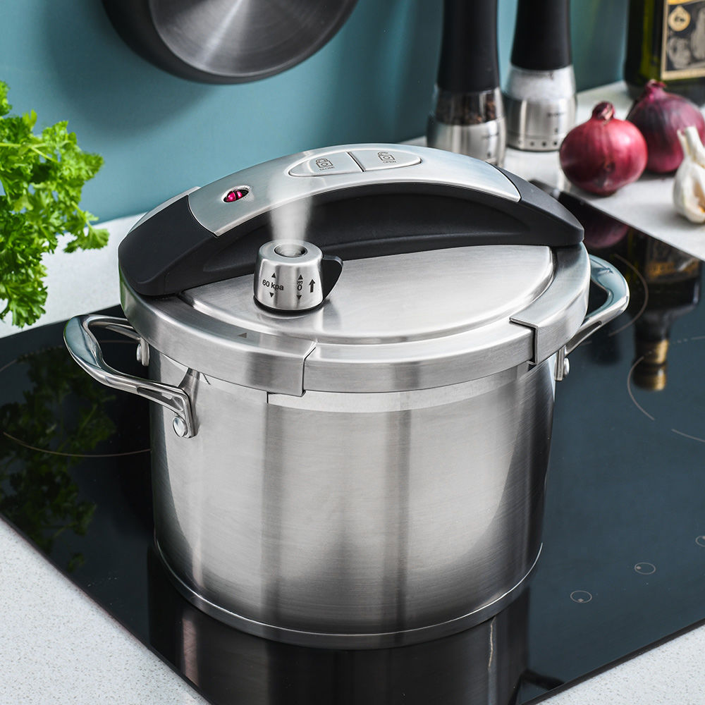

PC ideas

Slide 4
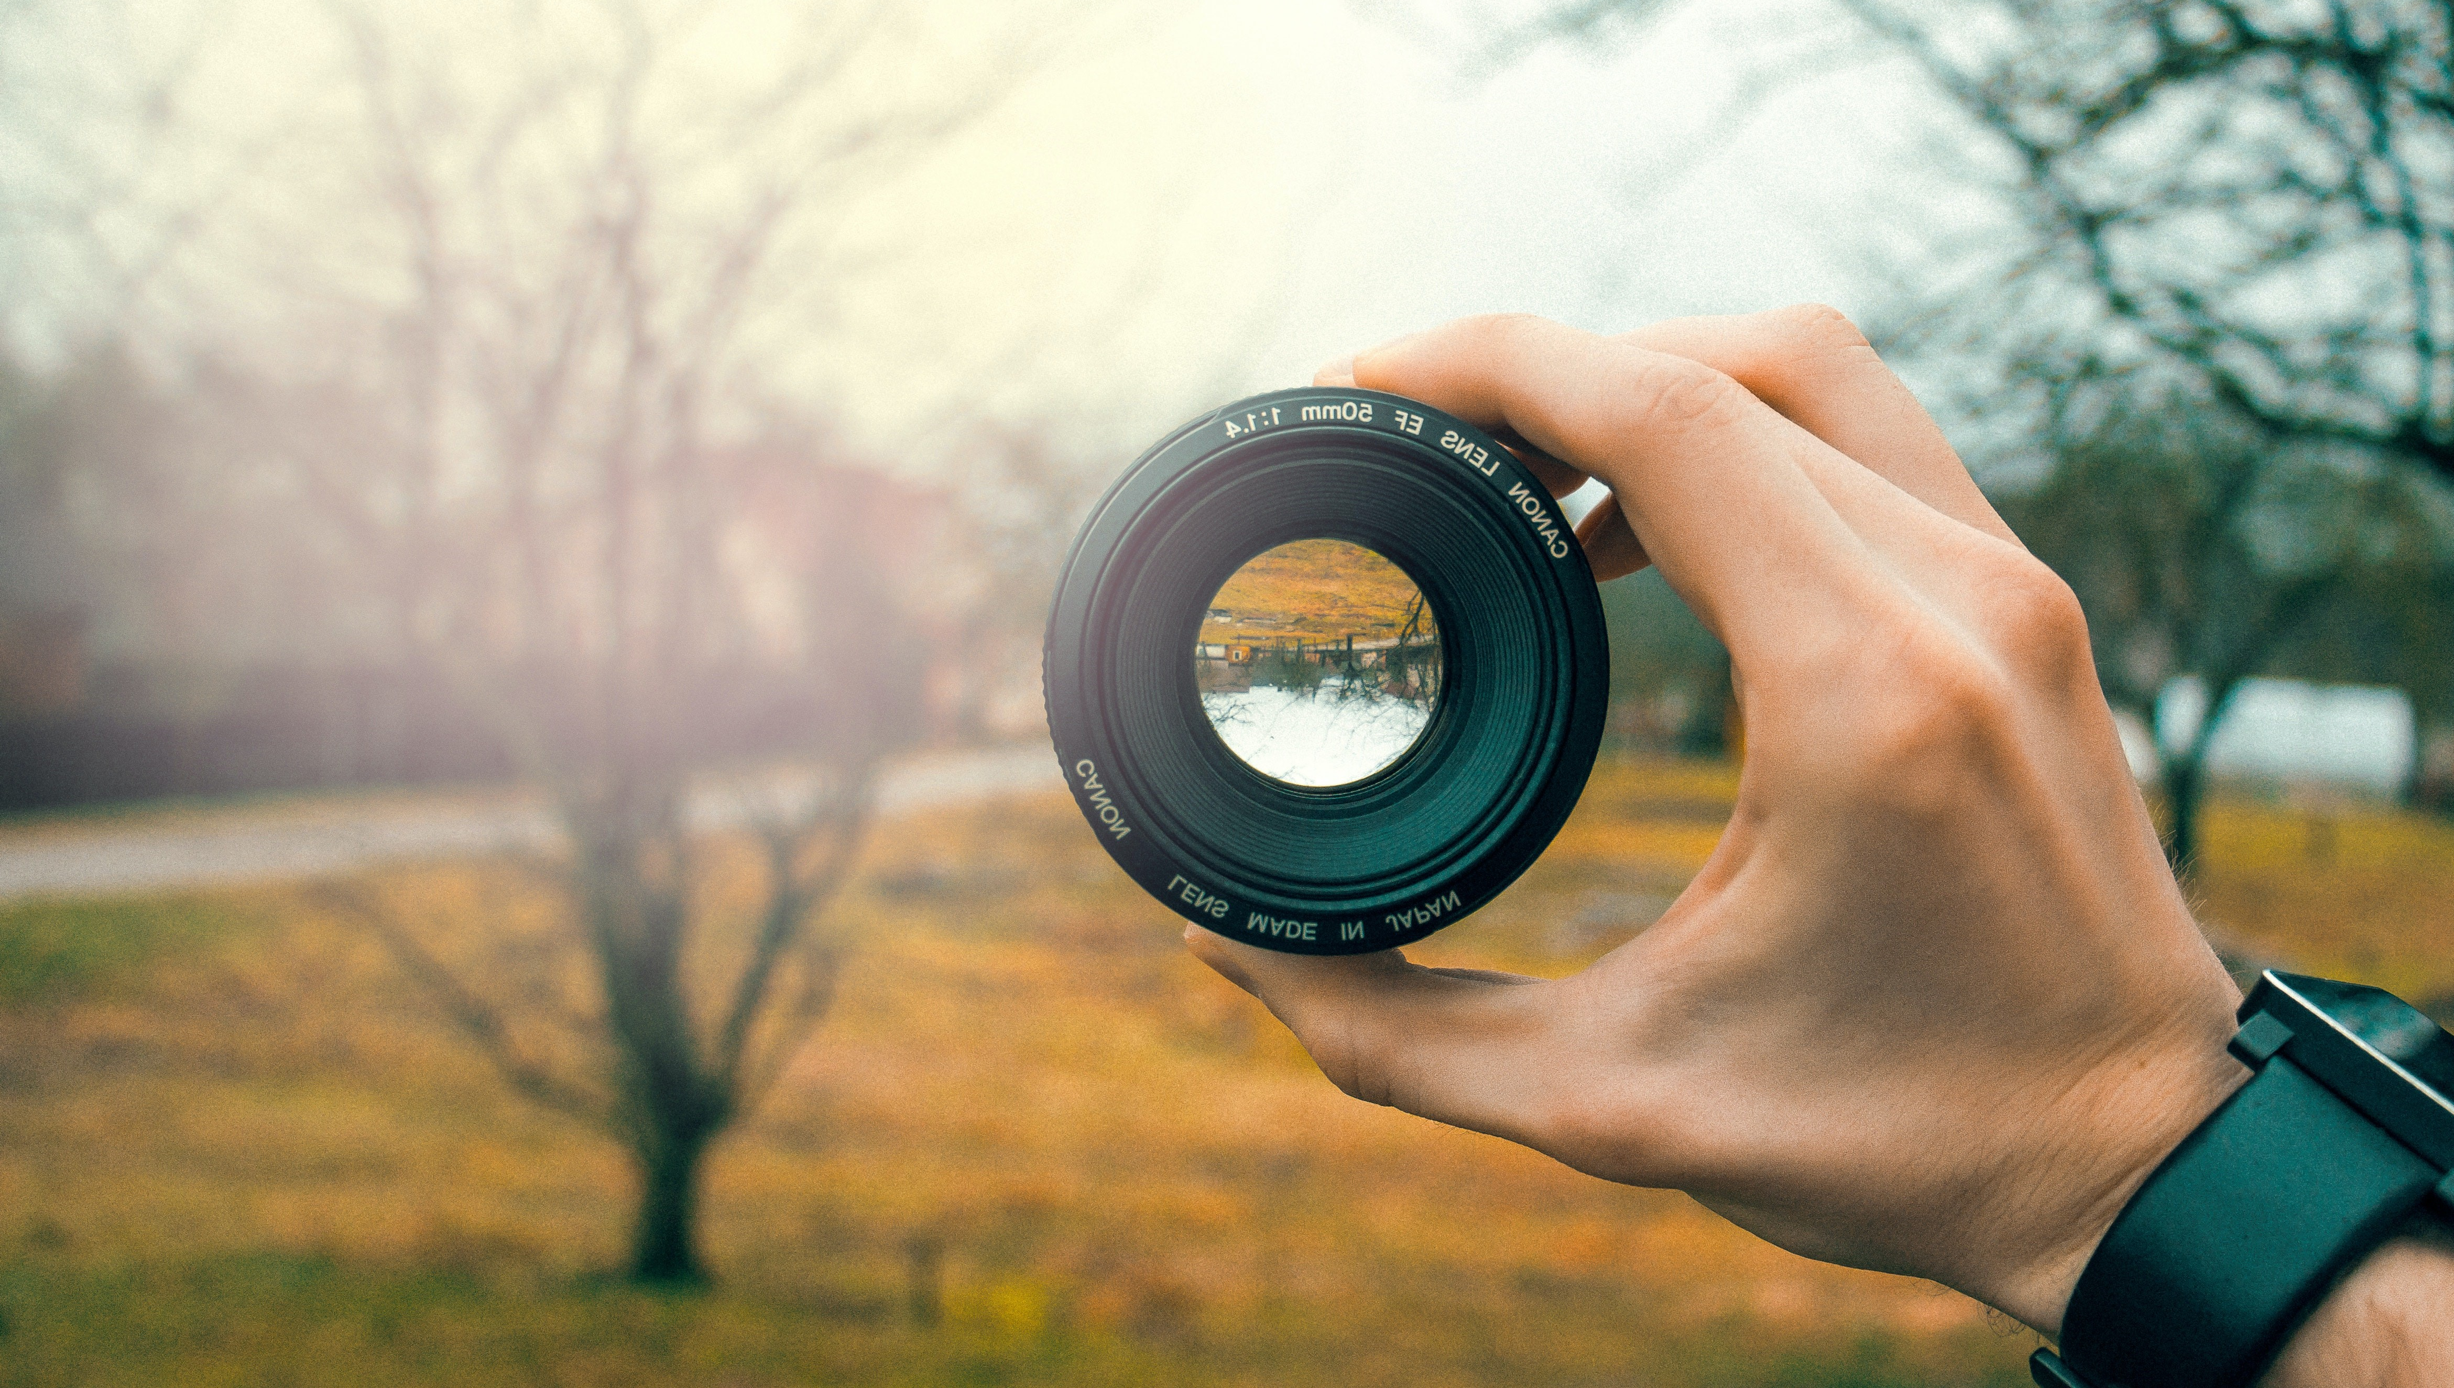
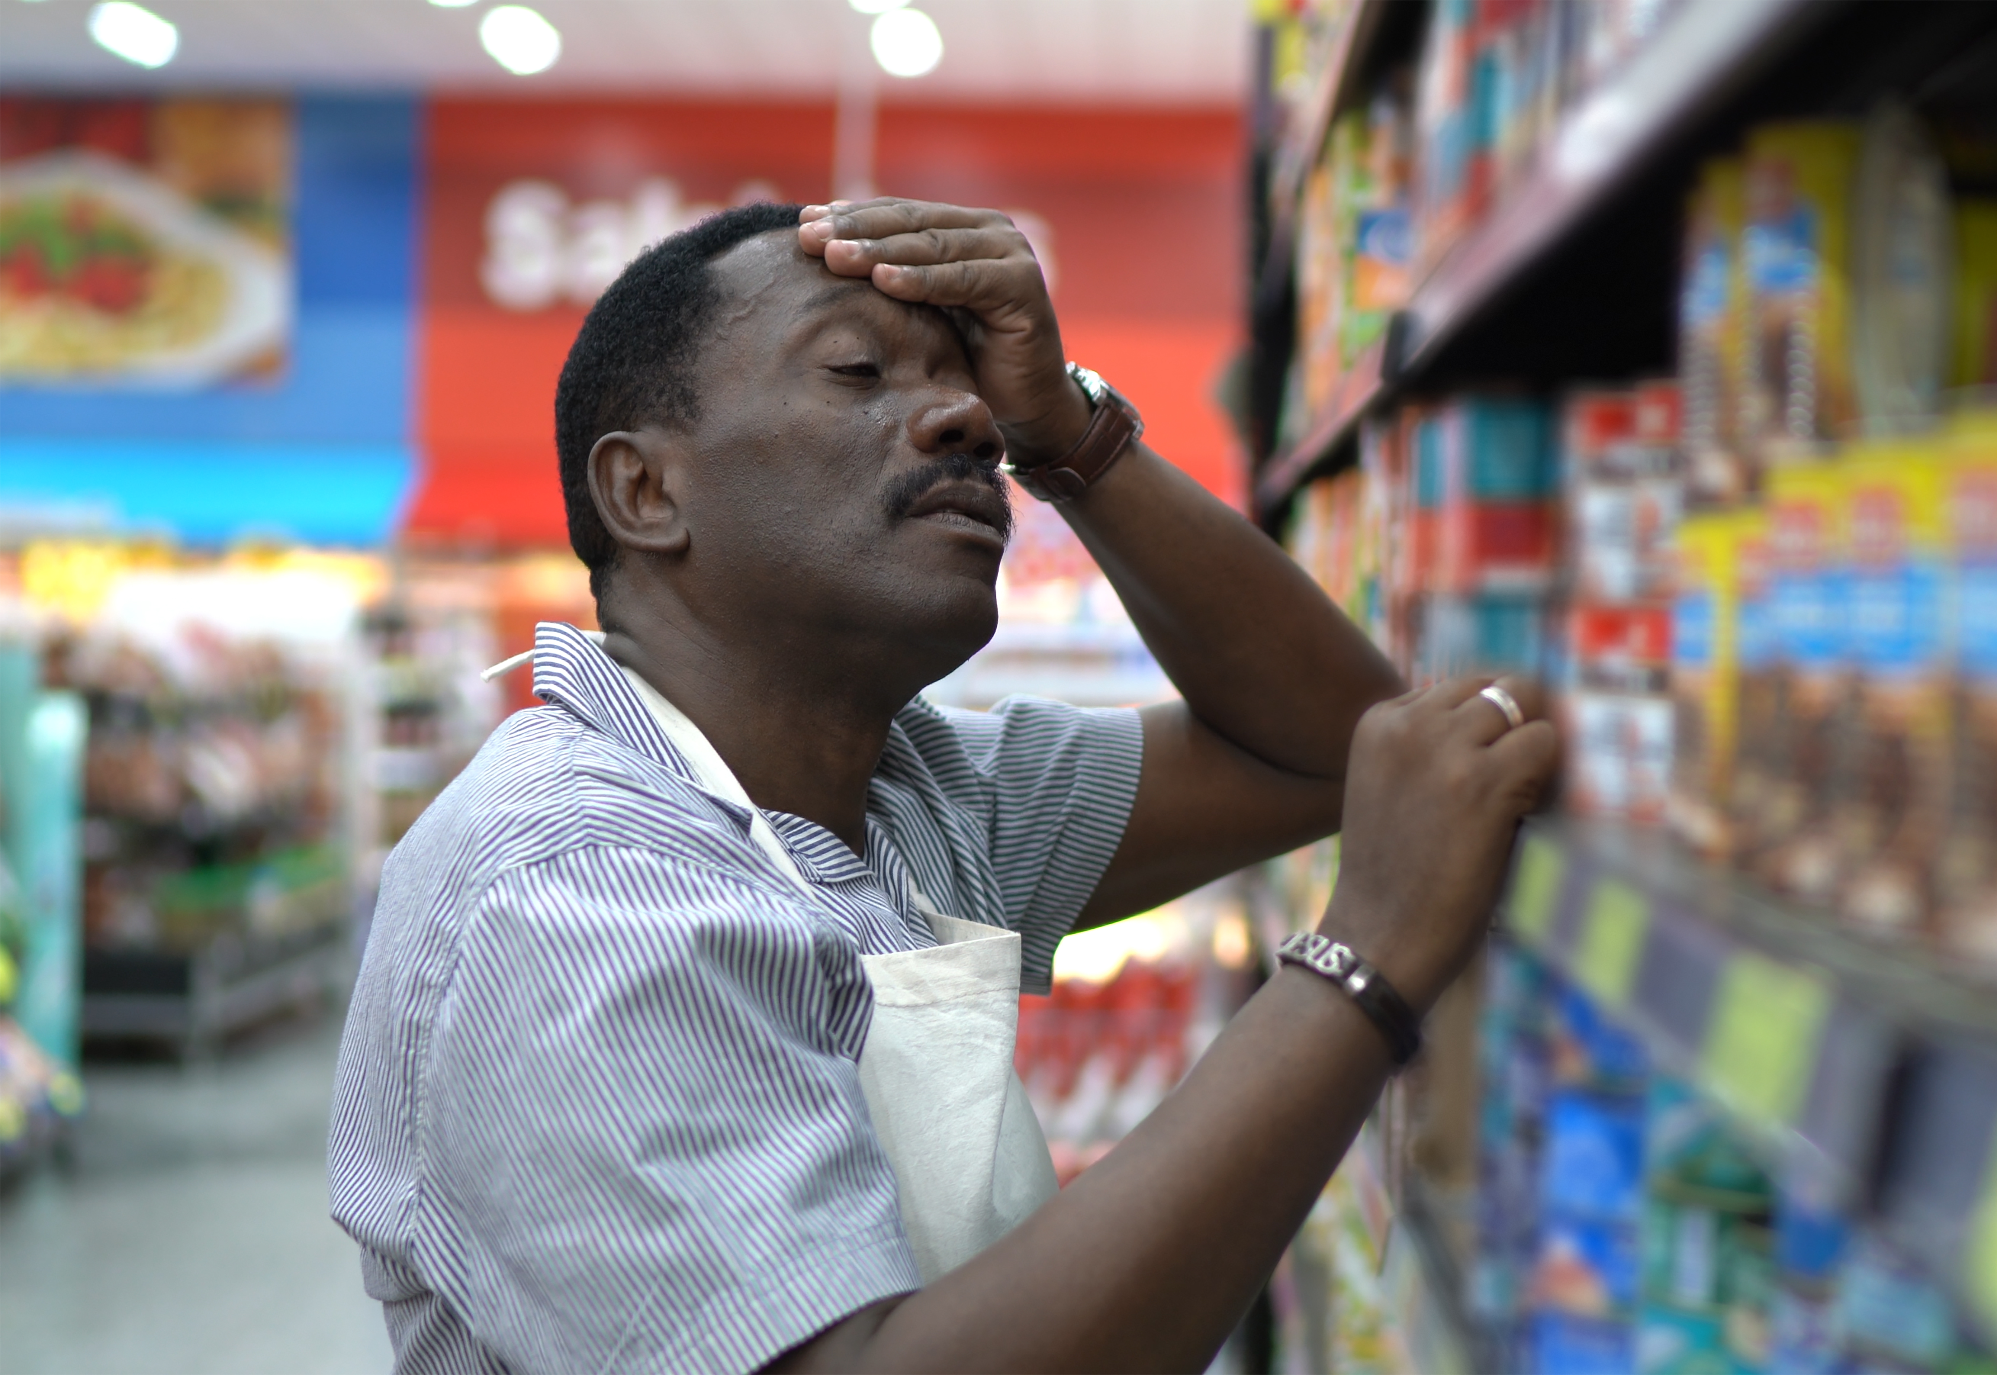
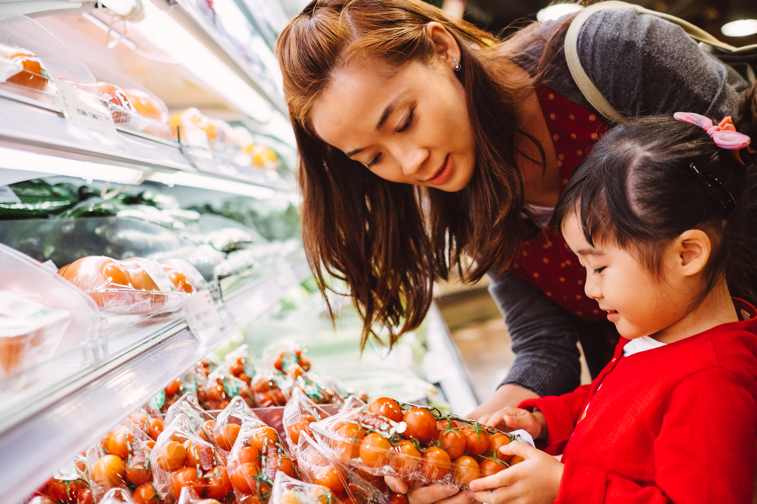
Challenges
How to involve children in grocery shopping?
How to make the in-store experience more entertaining?
How to enable a more fluent shopping experience?

Slide 5
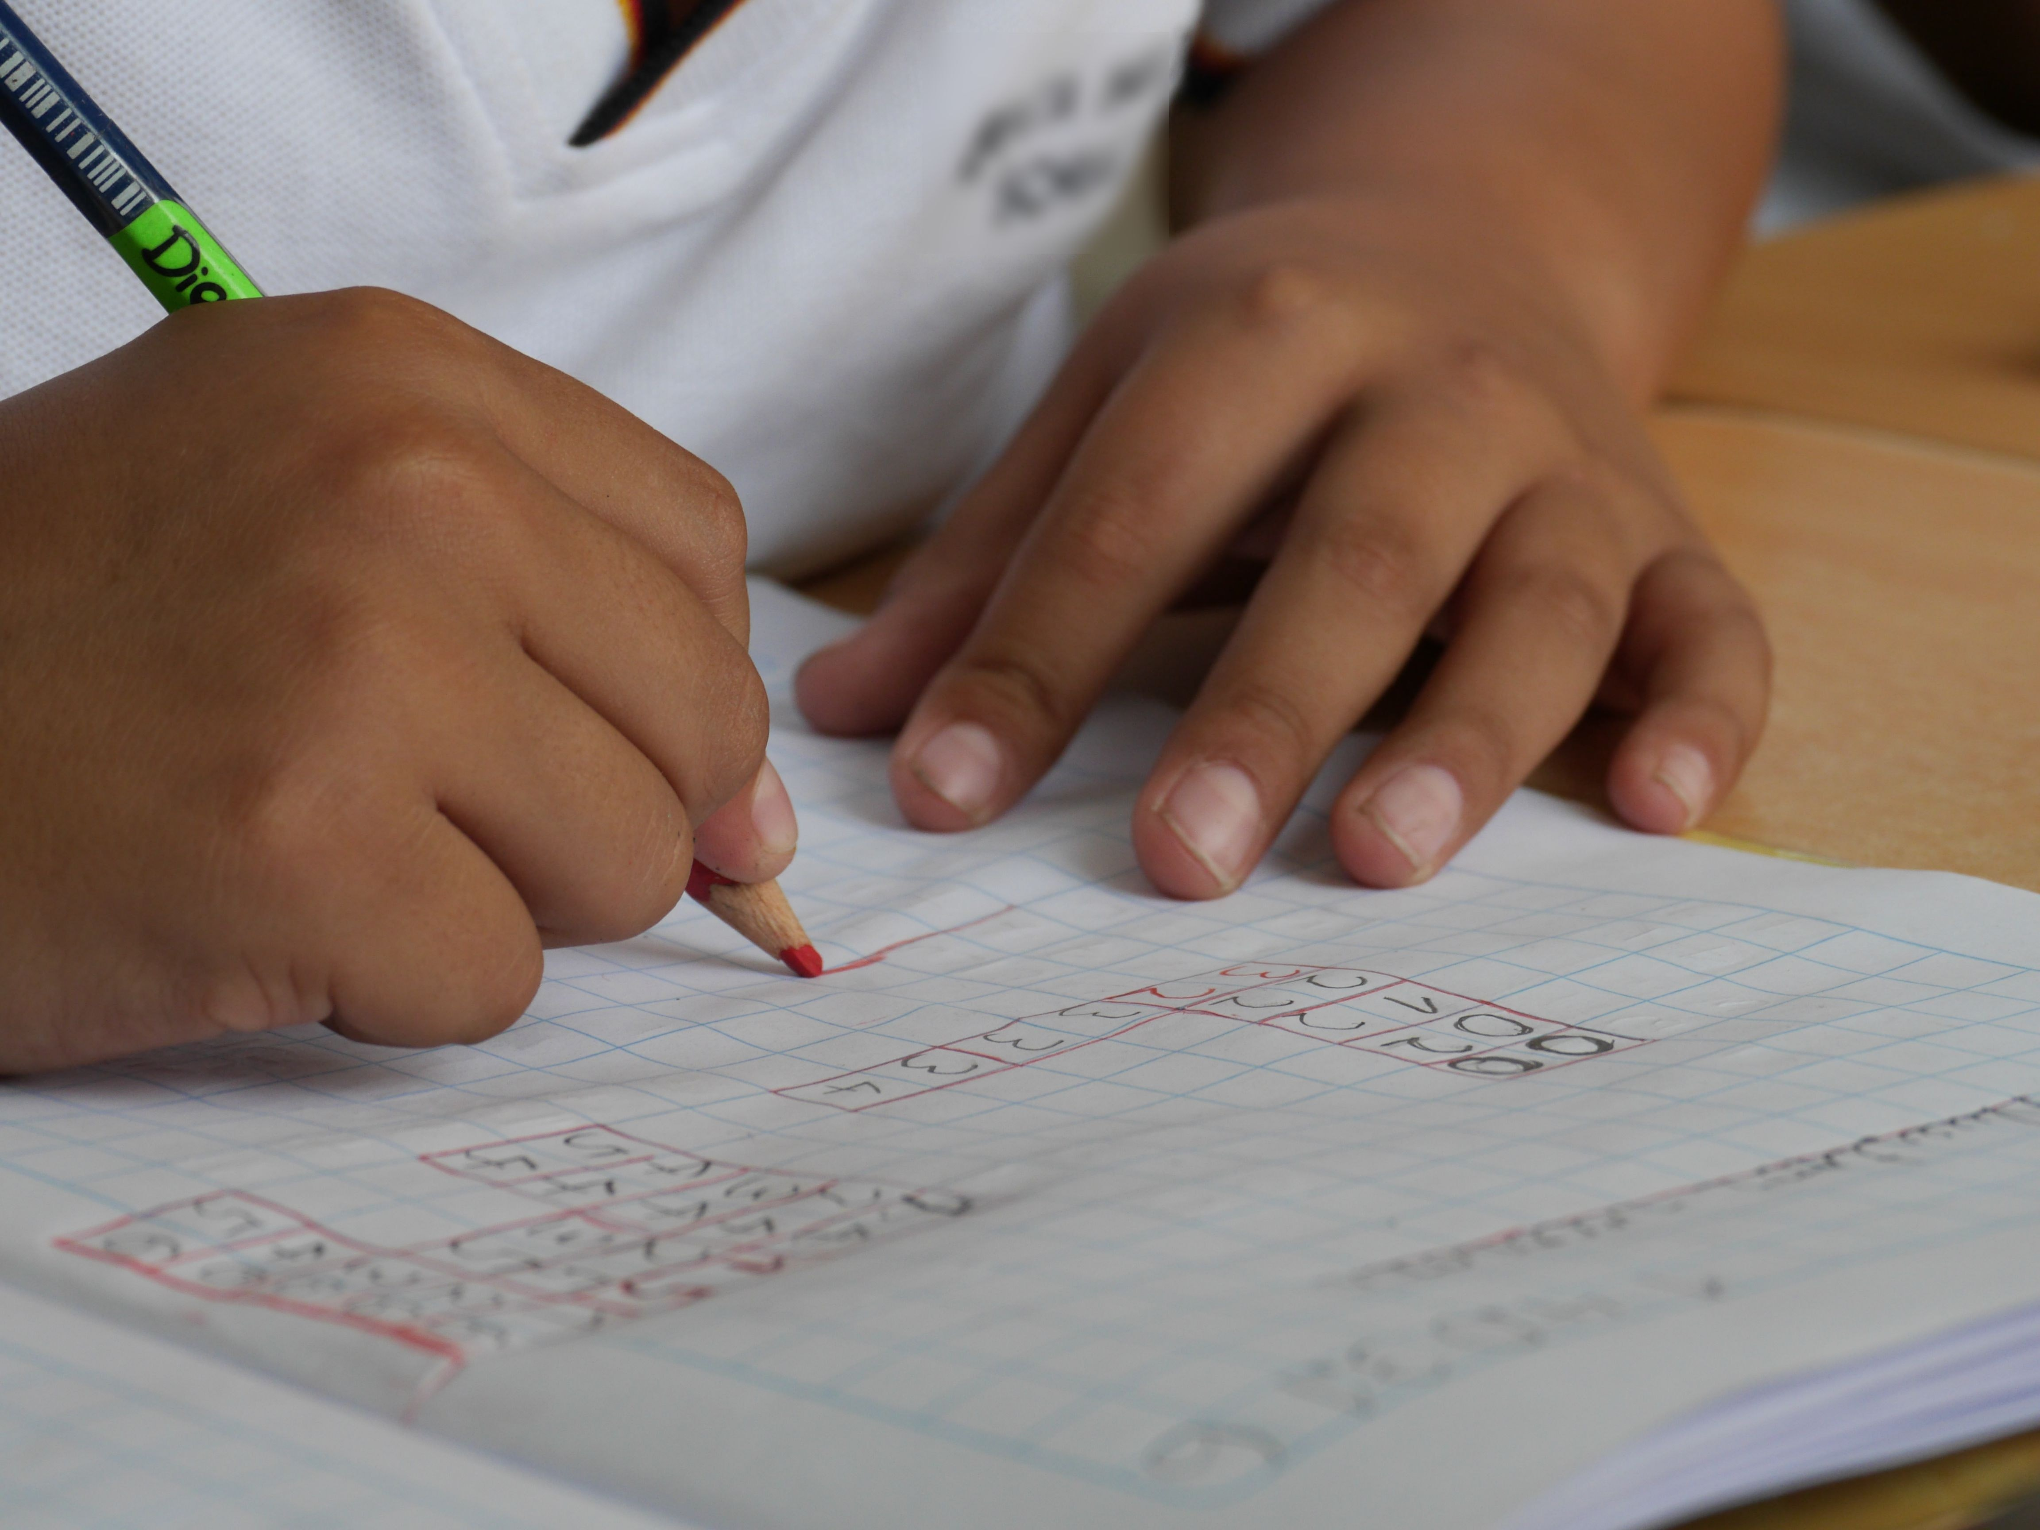

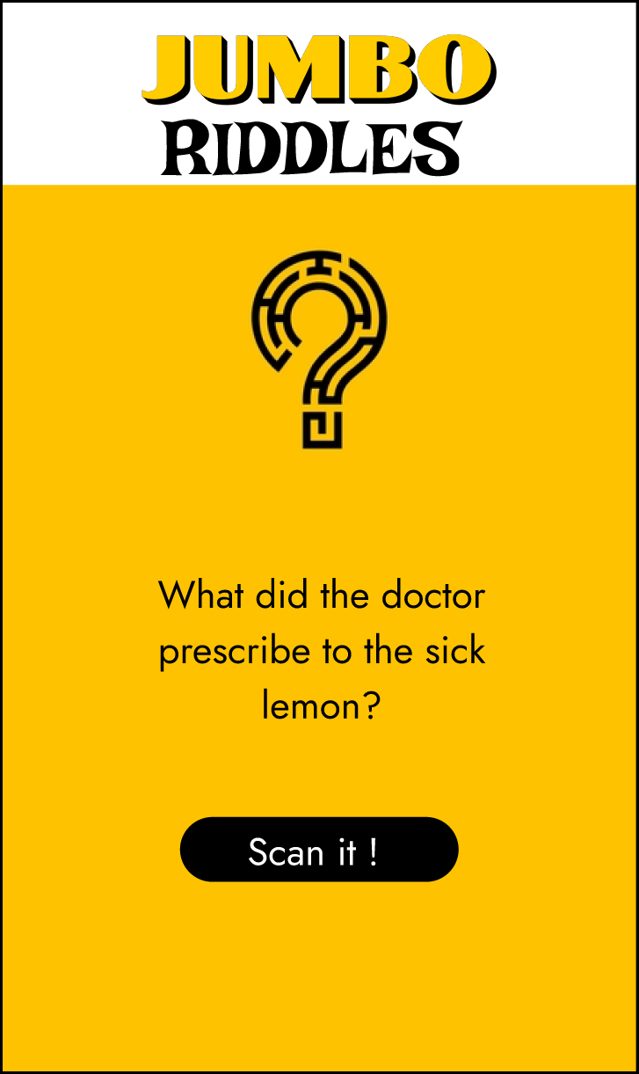
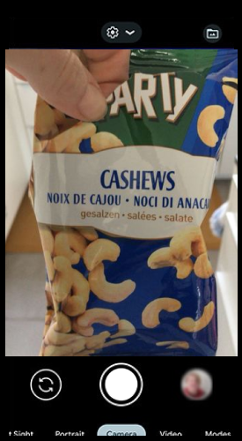
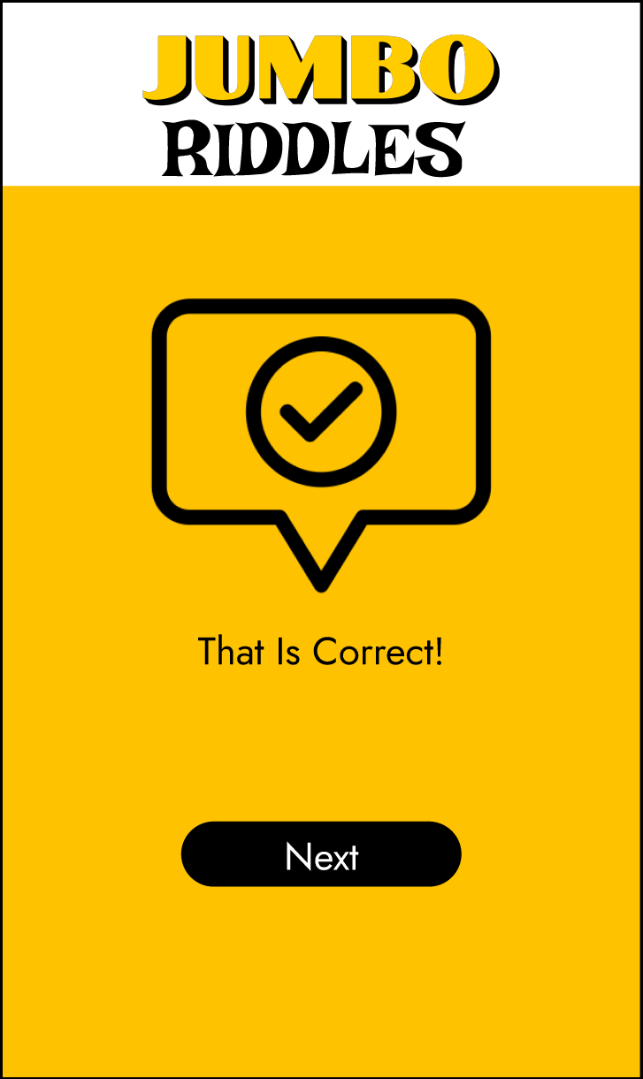
Jumbo Riddles
Notes:
Adds interactive fun element and draws customers (they touch and attention) to specific products Engaging & family-friendly
Interaction with products
Can be part of the main app
Can be rewarded

Slide 6


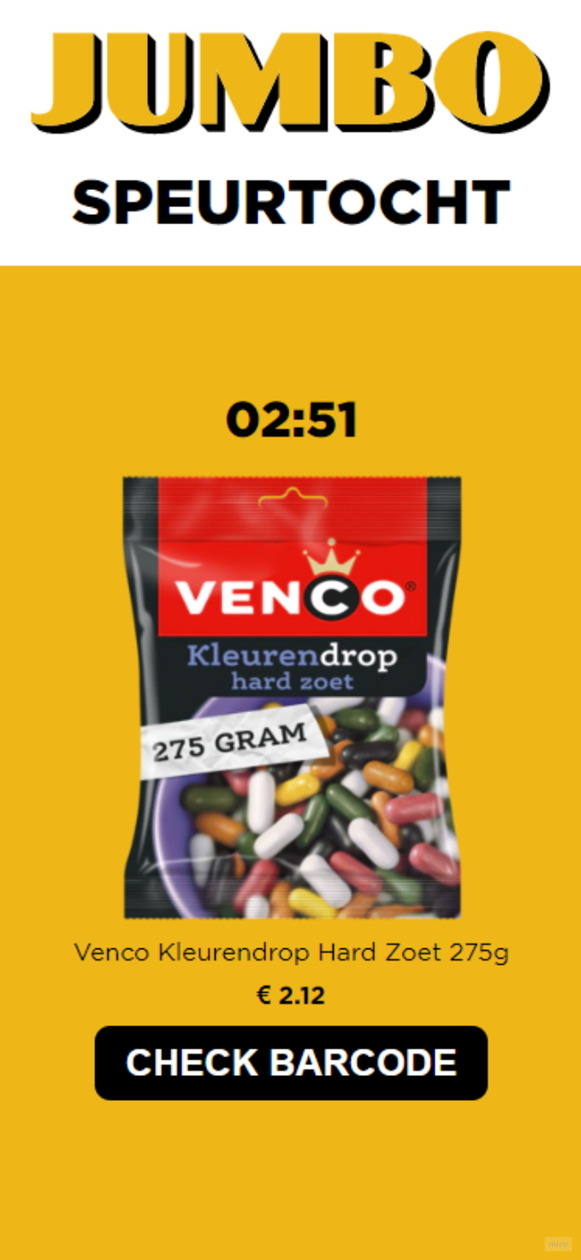
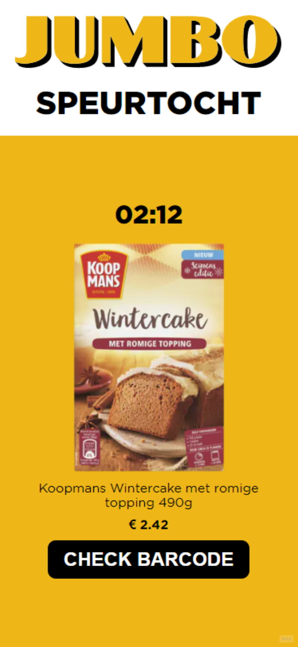

Jumbo Live Speurtocht
Notes:
In short: a scavenger hunt to find products in the store.
- Interactive & fun, and it has potential to be a fun group activity as well.
- It allows the user to engage and interact with real life products
- It spotlights products and brands that the user might not have seen yet, so it has potential to promote unpopular products.
- Money saving - *inflation

Slide 7
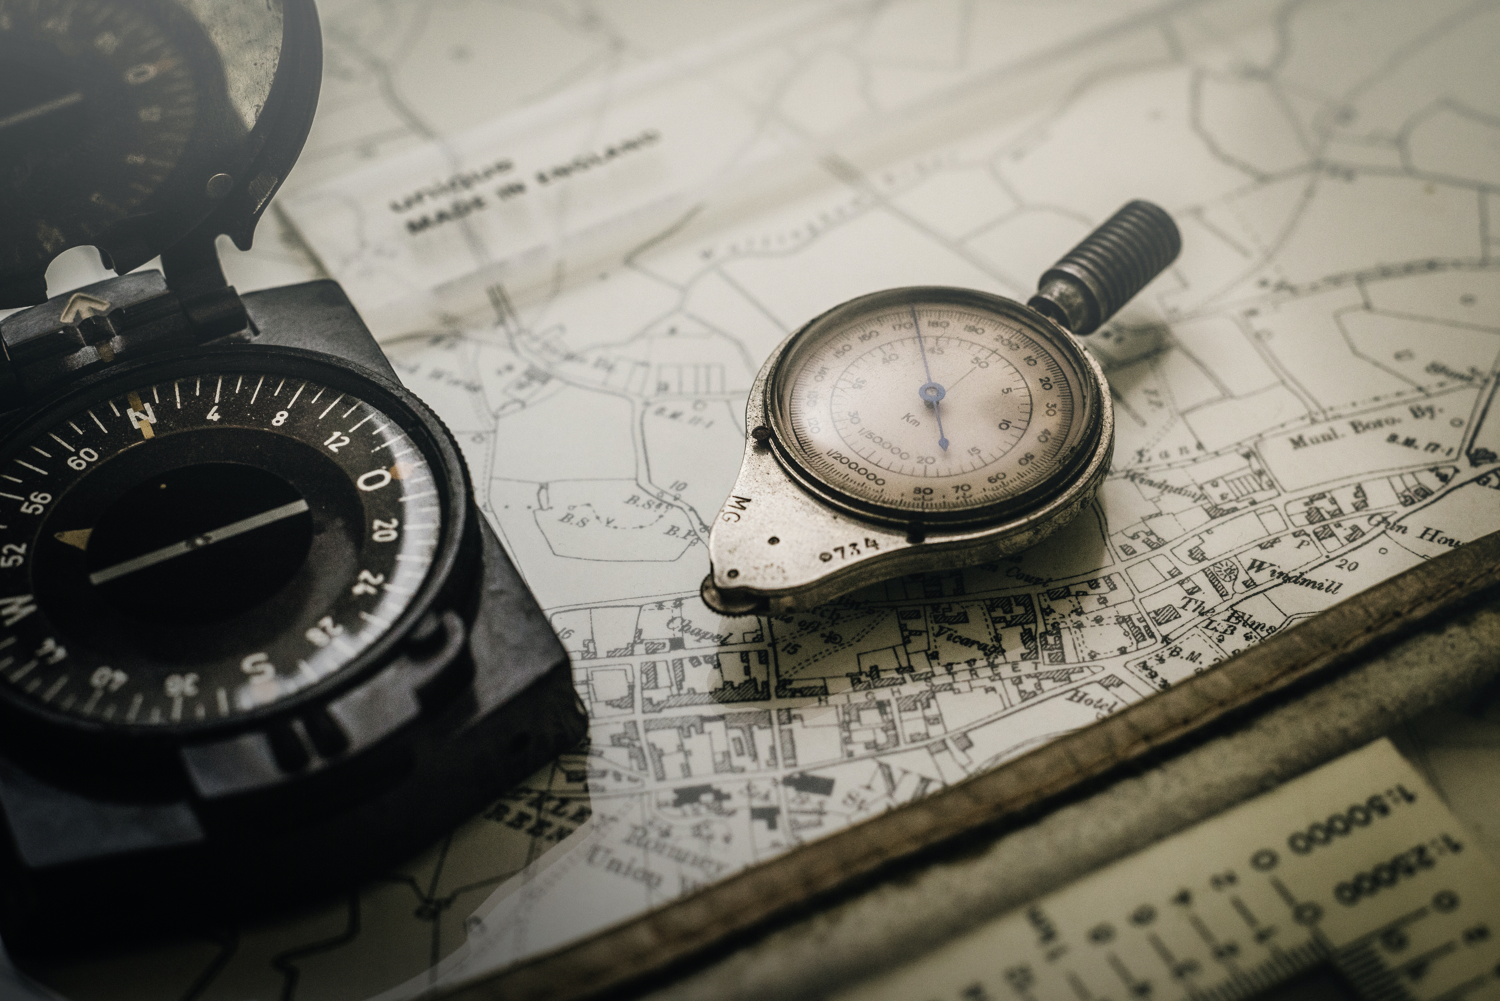
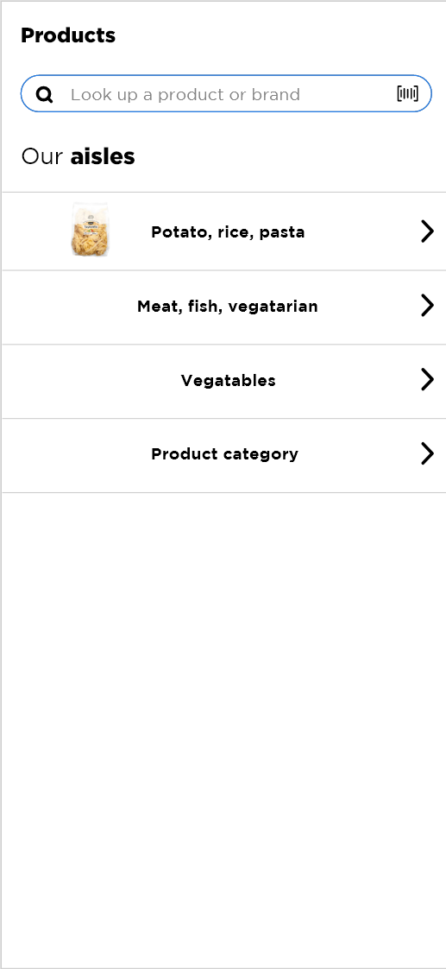
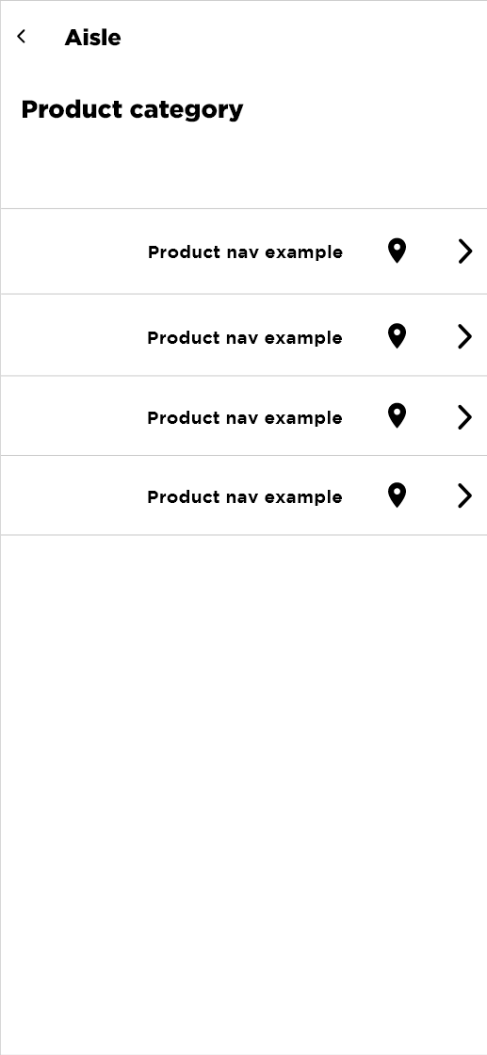
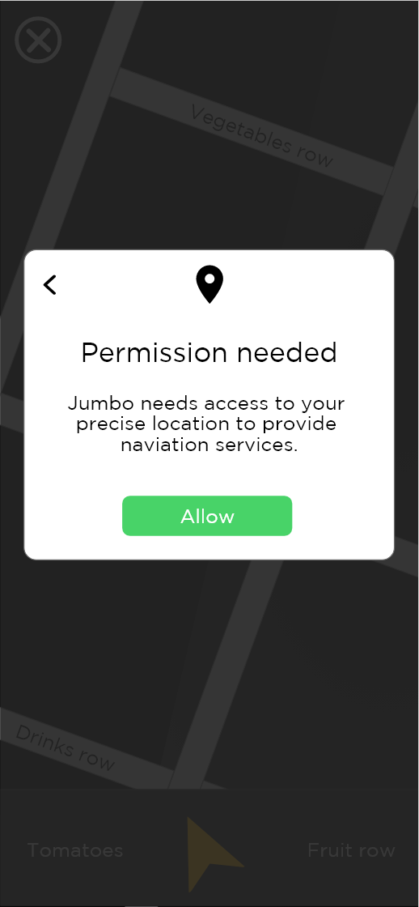
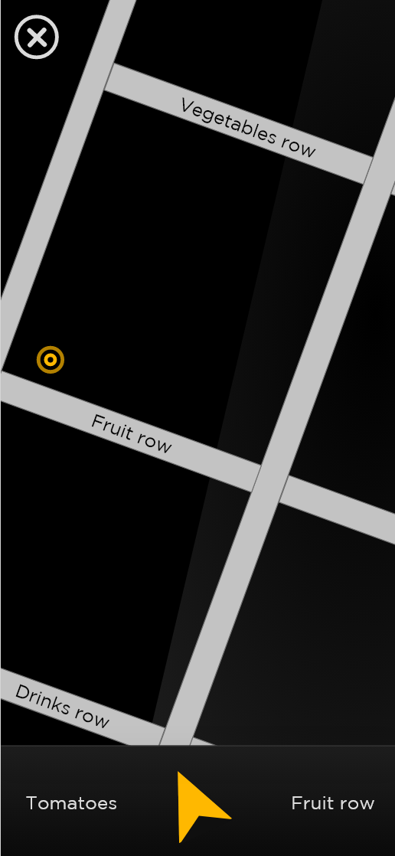
Store Navigation
Notes:
Convenient & efficient
Potential crowd control
Personal shopping list with route
Could suggest substitutes

Slide 8
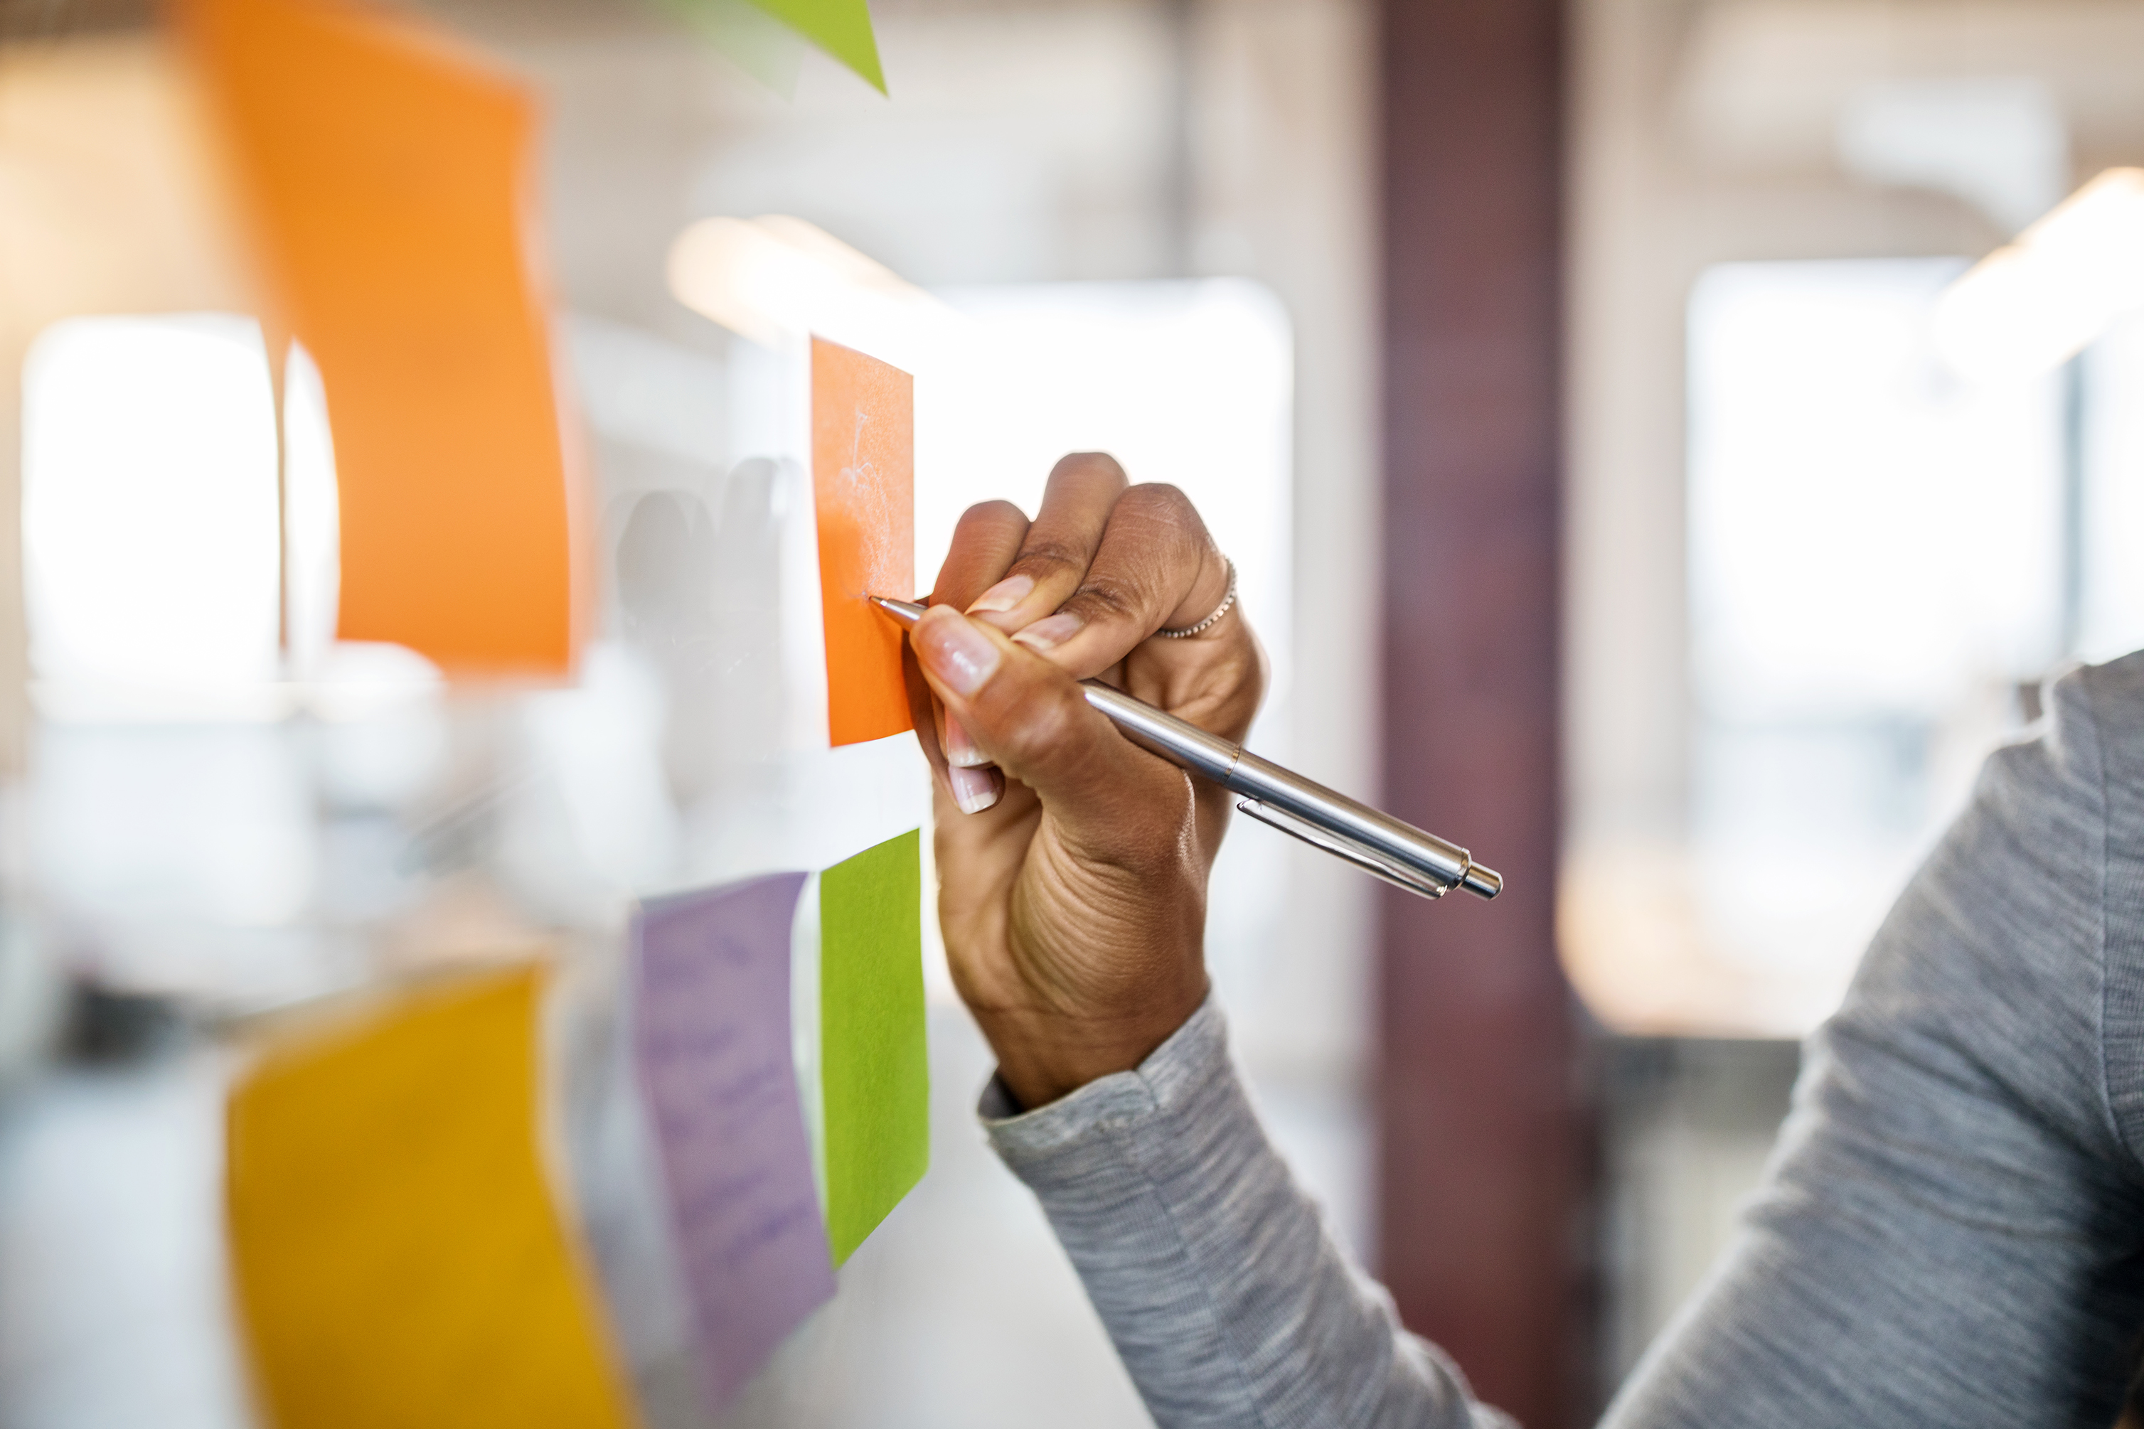
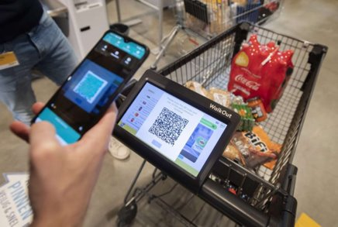

Karel the Cart
Notes:
Ideas we would like to develop further

Slide 9
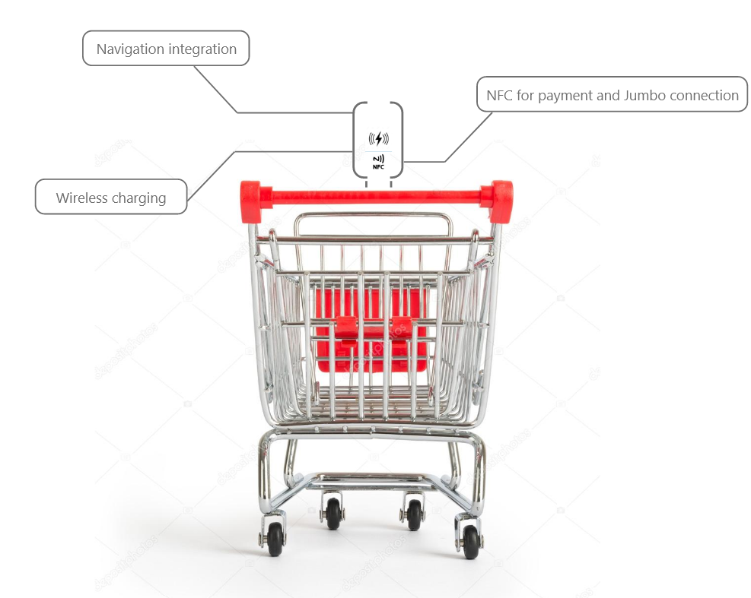
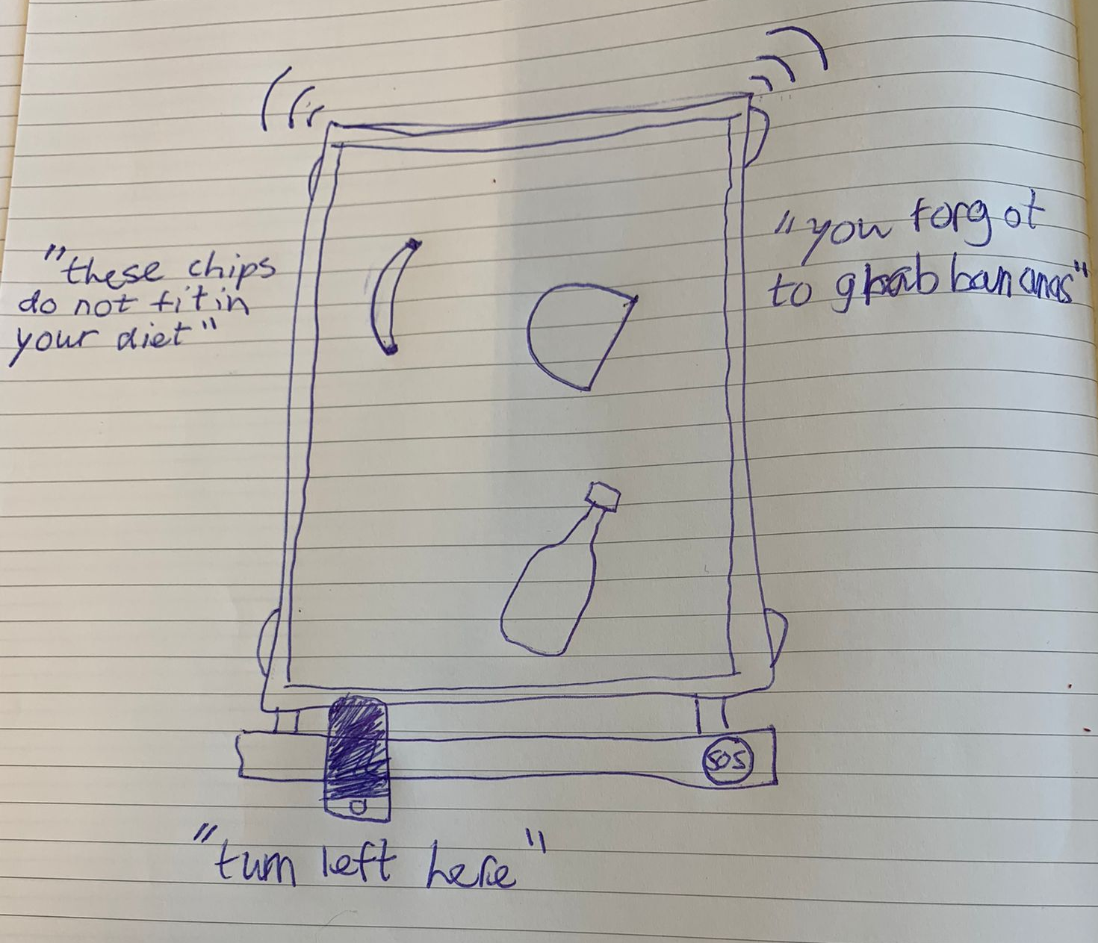
The Idea
"Smart" cart with character
Personalization
Navigation
Theft prevention
"Just walk out"
Notes:
Inspiration from Jumbo philosophy as well as competitor analysis

Slide 10
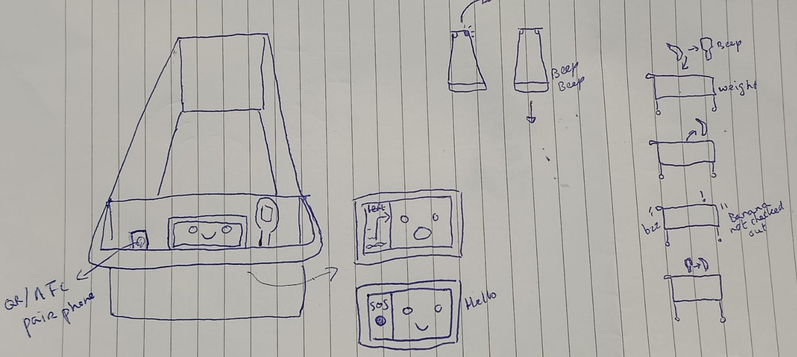
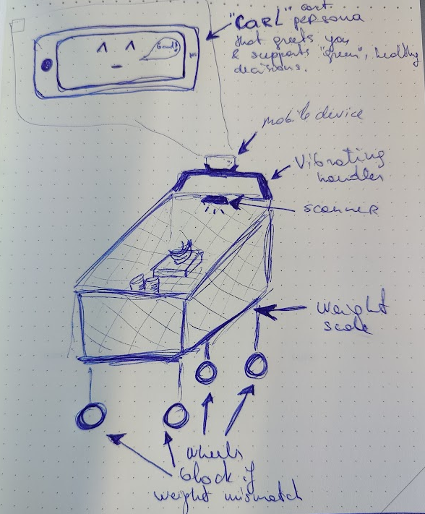
Features
Sync with phone
Wireless charging
Route based on shopping list
Lights, vibrations, sounds
Signaling
Weight sensitive bottom
SOS/Help button

Slide 11

Feedback & Questions
Notes:
PROPOSAL!!!!

